Slide 1
Solid Edge AddIns
Jason Newell, Applications Architect, The Charles Machine Works, Inc.

Slide 2
Solid Edge AddIns
Solid Edge AddIns are notoriously difficult to develop. Especially if you’re not using C++. I could be wrong but I believe I was the first person to ever successfully develop a .NET Solid Edge AddIn. I only mention that to give you an idea of how long I’ve been working on this problem. There are so many issues to deal with that most people simply abandon development. I have personally done so on a number of occasions over the years.
I will say though, that as I stand here in front of you today, I couldn’t feel more confident that we now have a much clearer path for developing .NET Solid Edge AddIns. It all starts with the tremendous amount of effort that I’ve put into the github.com/SolidEdgeCommunity/SolidEdgeContrib project. That library makes creating .NET Solid Edge AddIns a snooze. I’m not even joking… Plus, we now have Solid Edge Community Templates at visualstudiogallery.msdn.microsoft.com which gives us Visual Studio 2012 and 2013 project templates. Could this get any easier?

Slide 3
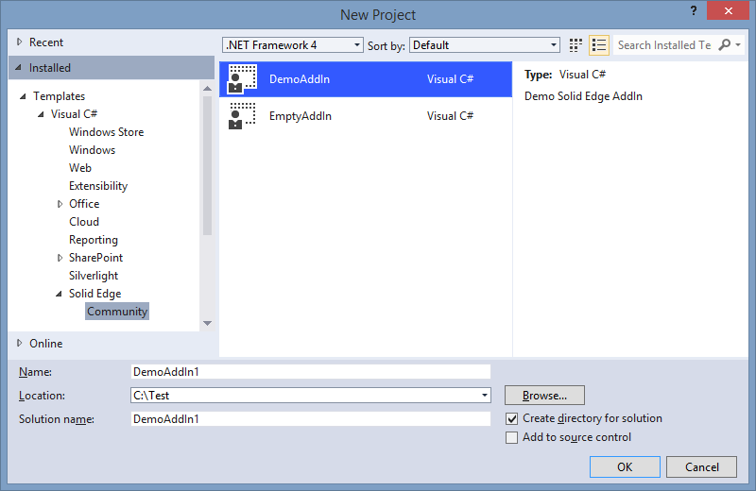
Solid Edge AddIns
The answer is yes. Now that we have the github.com/SolidEdgeCommunity, development will continue to progress and make things even easier. What would you say if I told you that you can create a .NET Solid Edge AddIn, complete with EdgeBar, RibbonBar, OpenGL\GDI+ View overlays and more in 10 seconds?

Slide 4
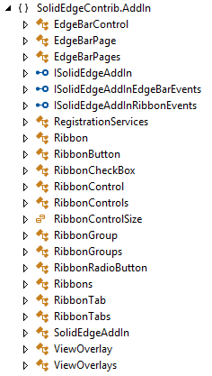
Demo
The SolidEdgeContrib library has an entire namespace dedicated to Solid Edge AddIns. This is functionality that is not available in the standard Solid Edge API. The SolidEdgeContrib library is build on top of the Solid Edge API and picks up where the Solid Edge API stops.
What if I told you that the minimum amount of code required to write an addin was around 30 lines of code? I’m sure that I could get it smaller than that but you get the point.

Slide 5
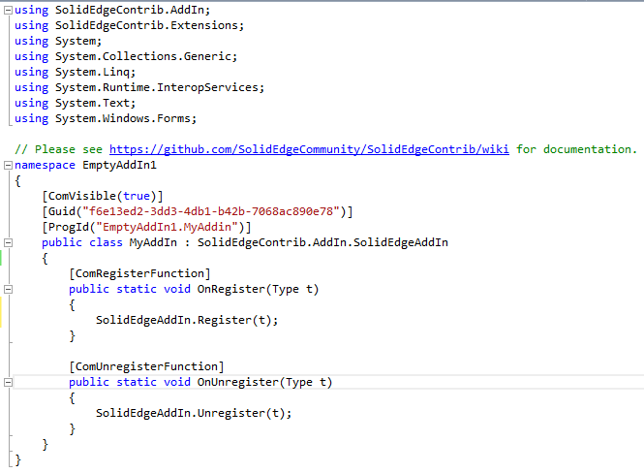
Minimum code required

Slide 6
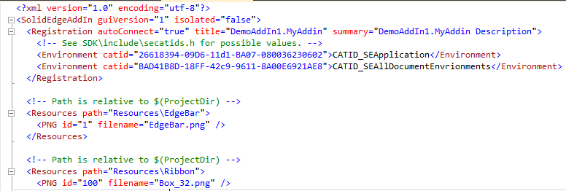
addin.manifest (The Magic)
So how is all of this possible? XML is the answer. The SolidEdgeContrib library is built to leverage a custom embedded addin.manifest that allows you to very simply describe your addin without caring about what’s involved “under the hood” in implementing the code against the base Solid Edge API.

Slide 7
Win32 resources
If you’ve ever tried to develop a Solid Edge AddIn, you know how much trouble it is to try and coerce a .NET assembly to include native Win32 resources. This is necessary because Solid Edge only supports native Win32 resources. So if you want any graphics in your addin, you must use native Win32 resources.
SolidEdgeContrib to the rescue! The SolidEdgeContrib NuGet package does more than install the library. When you install the package, it adds a custom MSBUILD .targets file that executes github.com/SolidEdgeCommunity/EmbedResources during the AfterBuild event. This .exe scans your assembly for an embedded addin.manifest. If it finds one, it will read it and embed BMP & PNG resources defined and in the manifest into your addin assembly.

Slide 8
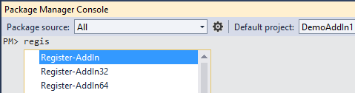
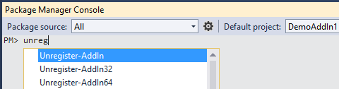
Package Manager Console Commands
In addition to handling native Win32 resources, the SolidEdgeContrib NuGet package also installs useful Package Manager Console commands. The NuGet Package Features are documented in the repository wiki. You’ll primarily want to be familiar with the following commands. They make registration of your addin a breeze.
Register-Addin
Unregister-AddIn

Slide 9
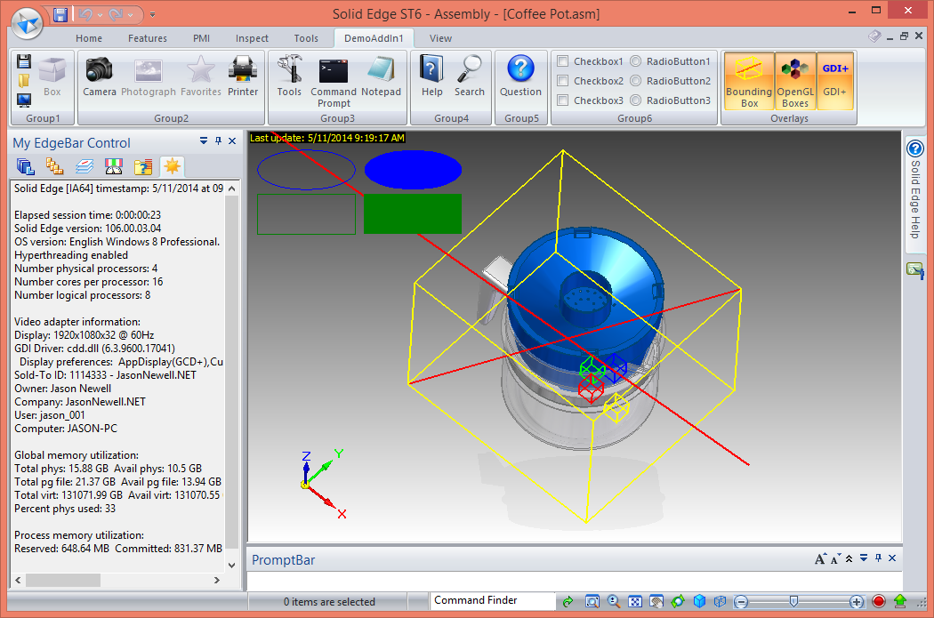
Demo

